Slide 1
BASIC ELECTRICAL & ELECTRONICS ENGINEERING

Slide 2
Course Objectives:
To expose to the field of electrical & electronics engineering, laws and principles of electrical/electronic engineering and to acquire fundamental knowledge in the relevant field.

Slide 3
Course Outcomes:
CO1: Extract electrical variables of AC & DC circuits using fundamental laws. (Understand)
CO2: Understand the operation of electrical machines and measuring instruments. (Understand)
CO3: Classify various energy resources, safety measures and interpret electricity bill generation in electrical systems. (Understand)

Slide 4
PART A: BASIC ELECTRICAL ENGINEERING

Slide 5
UNIT-I : DC & AC Circuits
DC Circuits: Electrical circuit elements (R, L and C), Ohm’s Law and its limitations, KVL, series, parallel, series-parallel circuits, Super Position theorem, Simple numerical problems.
AC Circuits: A.C. Fundamentals: Equation of AC Voltage and current, waveform, time-period,frequency, amplitude, phase, phase difference, average value, RMS value, form factor, peak factor, Voltage and current relationship with phasor diagrams in R, L, and C circuits, Conceptof Impedance, Active power, reactive power and apparent power, Concept of power factor (Simple Numerical problems).

Slide 6
DC Circuits: Electrical circuit elements (R, L and C), Ohm’s Law and its limitations, KVL, series, parallel, series-parallel circuits, Super Position theorem, Simple numerical problems.

Slide 7
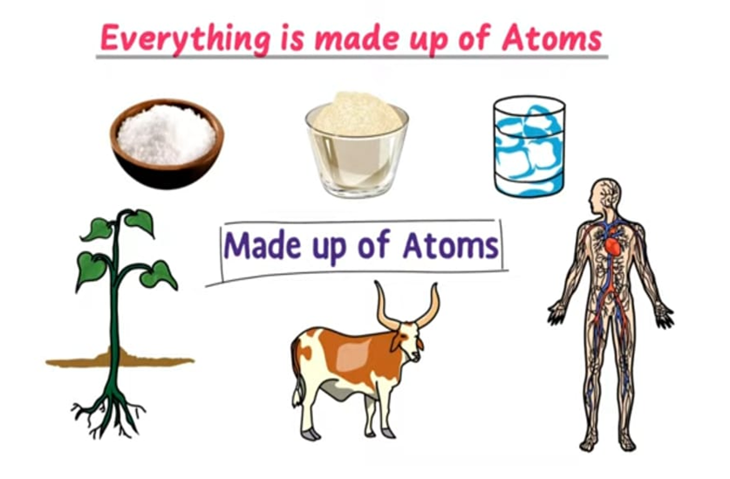

Slide 8
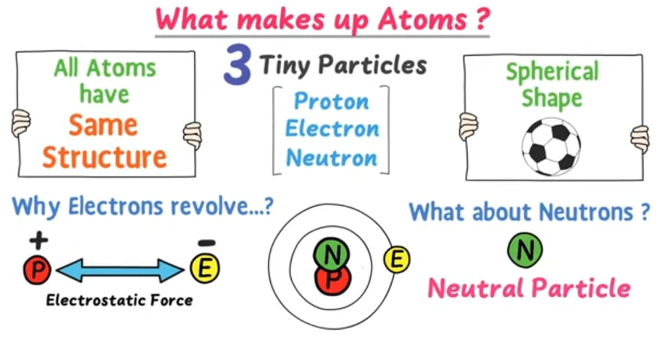

Slide 9
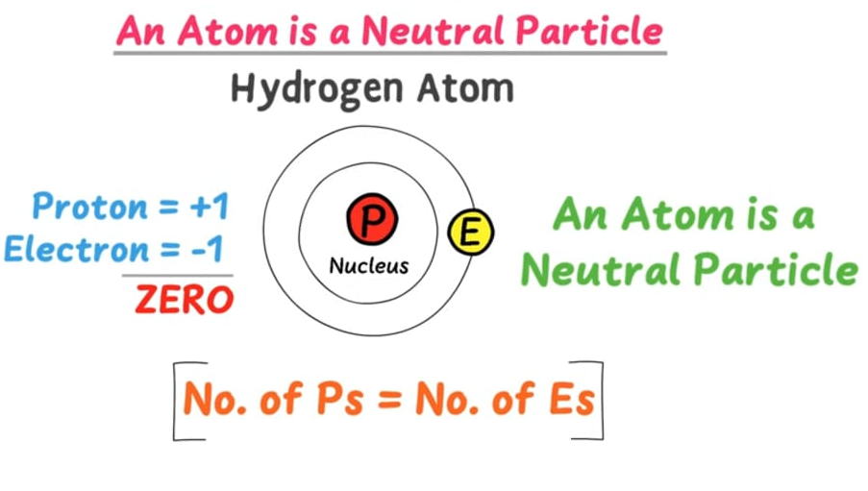

Slide 10
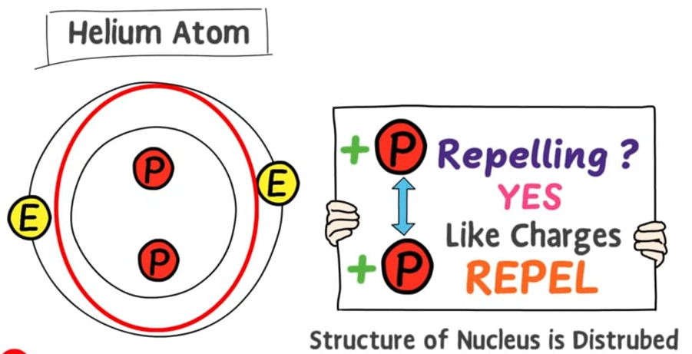

Slide 11
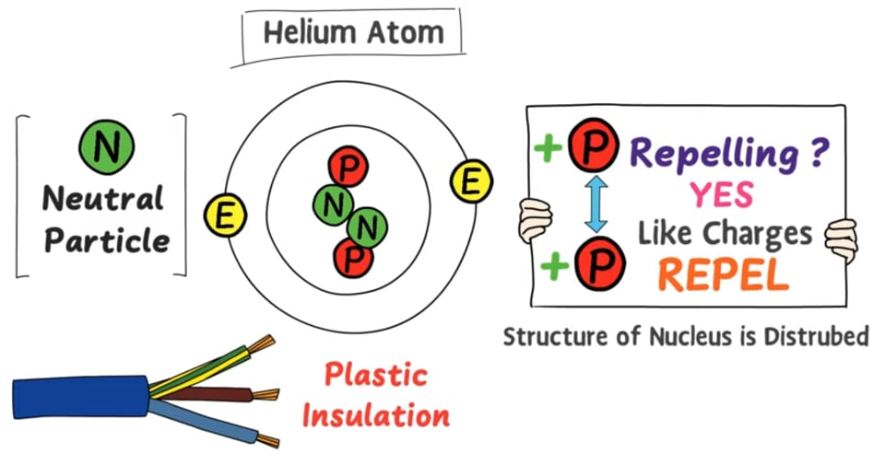

Slide 12
CHARGE:
All materials are made up of one or more elements.
An element is a substance composed entirely of atoms of the same kind.
An atom consists of a massive core (nucleus) carrying protons and neutrons. Electrons move around nucleus in orbits at distances that are large as compared to the size of the nucleus.
Each electron has a mass of kg and a negative charge,
– e, equal coulomb.
Each proton carries a positive charge, e, equal in magnitude to that of an electron.
A neutron carries no charge and its mass is almost same as that of a proton.

Slide 13
Under normal conditions, an atom is supposed to be electrically neutral.
The total positive charge on protons is equal to the total negative charge on electrons.
If an atom loses electron(s), it becomes positively charged. On the other hand, if an atom acquires excess electrons, it becomes negatively charged.
The charge is considered as the quantity of electricity.
The unit of charge is coulomb (C).

Slide 14
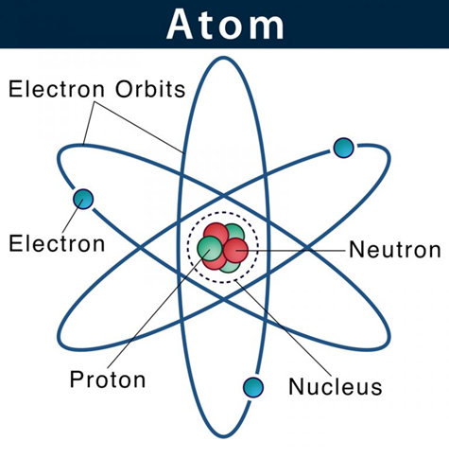

Slide 15

The atoms in a metal (such as Cu, Al, etc.) are packed together to form a solid.
In such a case, the loosely bound electron in the outermost orbit is free to move from one atom to the other throughout the solid. Such electrons are called free electrons.
When a free electron moves, it carries a negative charge with it. Hence, the free electrons in a metal work as charge carriers.

Slide 16
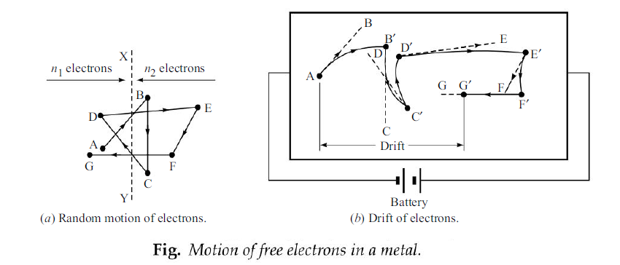
Drift Voltage:

Slide 17
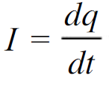
Electric Current:
Electric current is defined as rate of flow of positive charge.
The unit of current is ampere (A)
Types of Electric Current:
1)Uni-directional current ( Current flow always remains in one direction only)
2)Alternating Current (Current which keeps on reversing its direction continually)

Slide 18
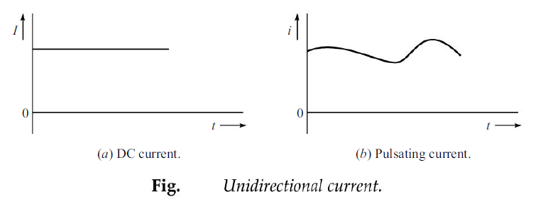
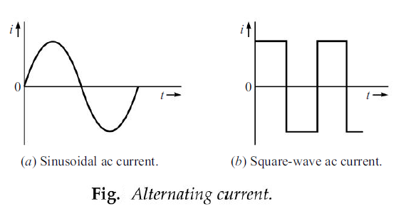

Slide 19
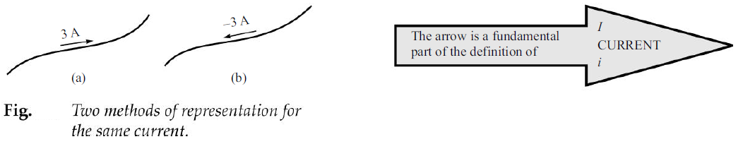

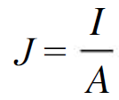
The current density in a conductor is the current per unit area of the cross section of the conductor.

Slide 20
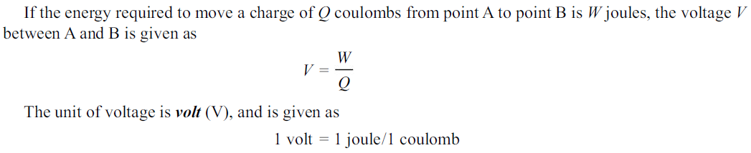
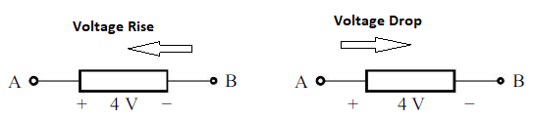
VOLTAGE OR POTENTIAL:

Slide 21
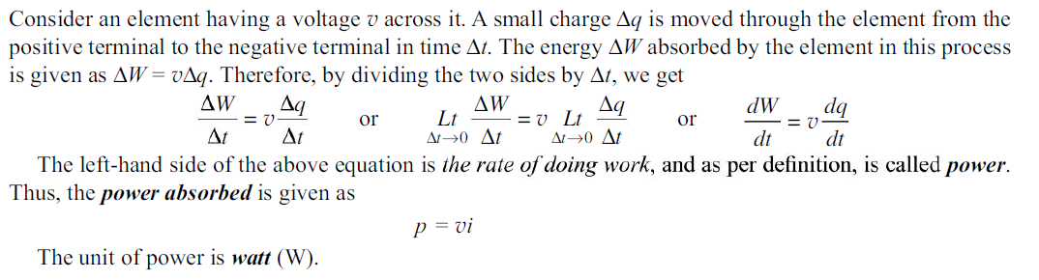
POWER:
Horse power (hp) is also used as a unit of power [1 hp = 746 W].

Slide 22
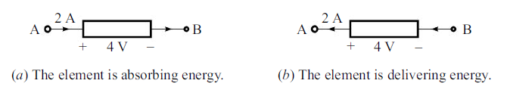

ENERGY:
Energy is capacity of doing work.
Energy = Work = Voltage *Charge = V * Q = V (It) = VIt = pt
Practical unit of electrical energy is kilowatt-hour(kWh).

Slide 23
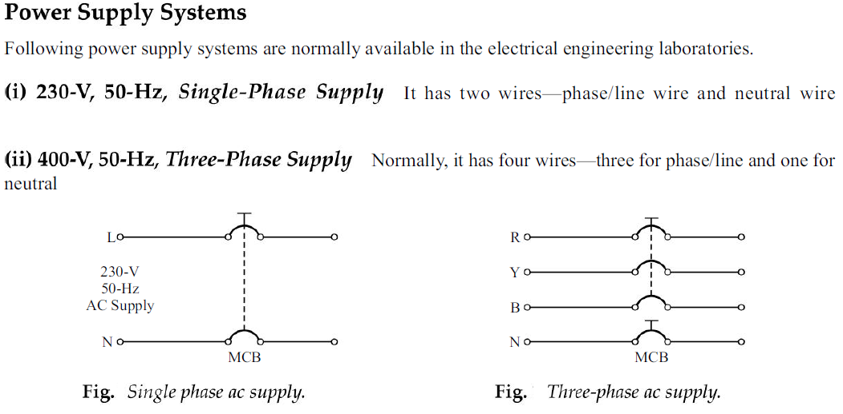

Slide 24
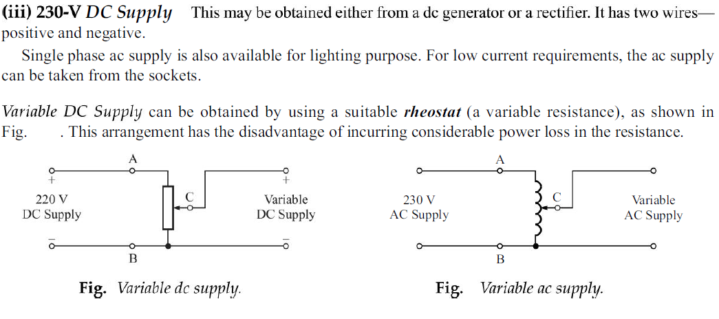

Slide 25
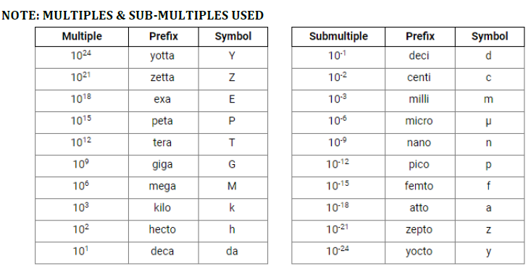

Slide 26
Types of Elements:
Active Elements (Element which supplies energy to a circuit)
Passive Elements (Element which can only receive energy, which it can either dissipate, absorb or store it in an electric field or a magnetic field)

Slide 27
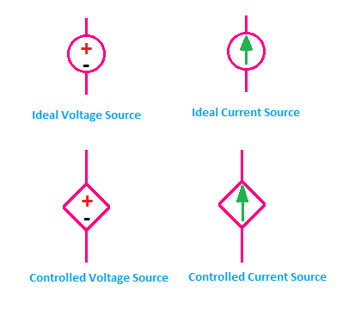
Active Elements
Voltage Source
Current Source

Slide 28
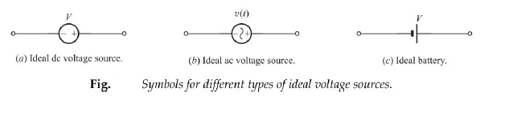
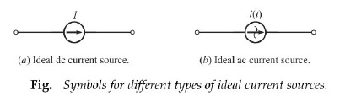

Slide 29
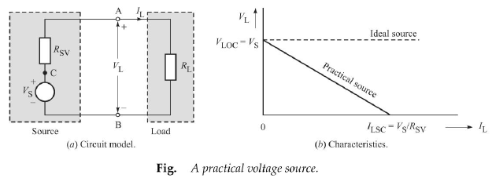
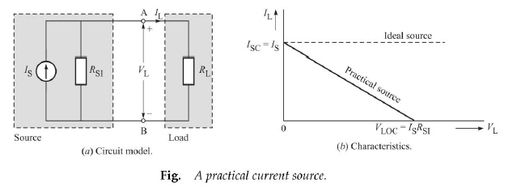

Slide 30
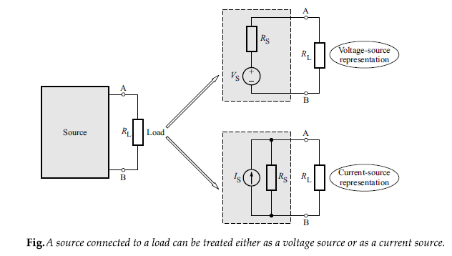

Slide 31
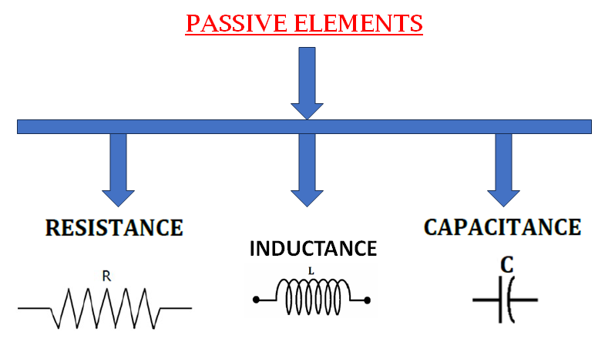

Slide 32
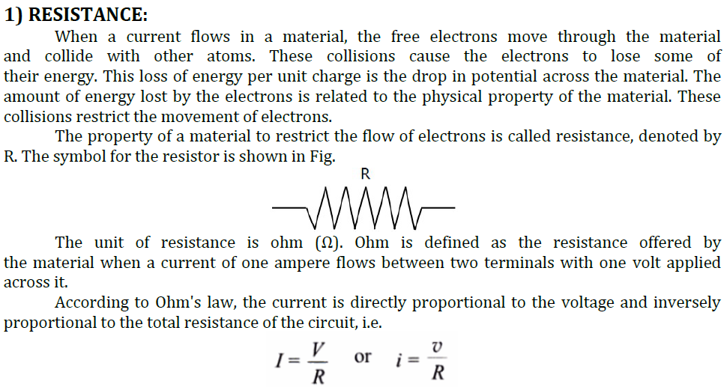

Slide 33
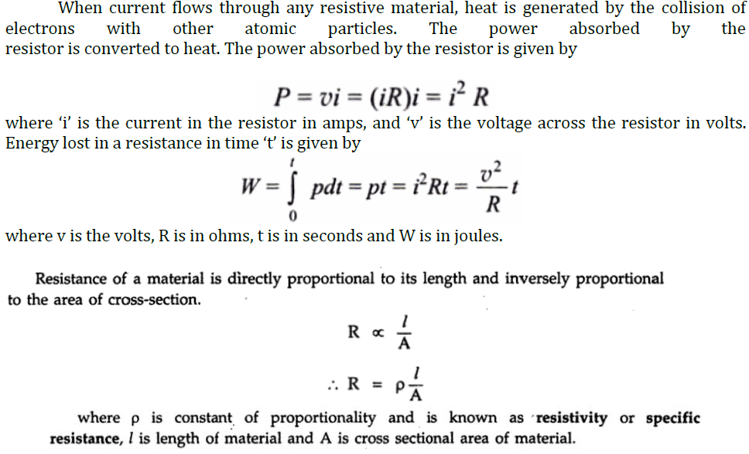

Slide 34
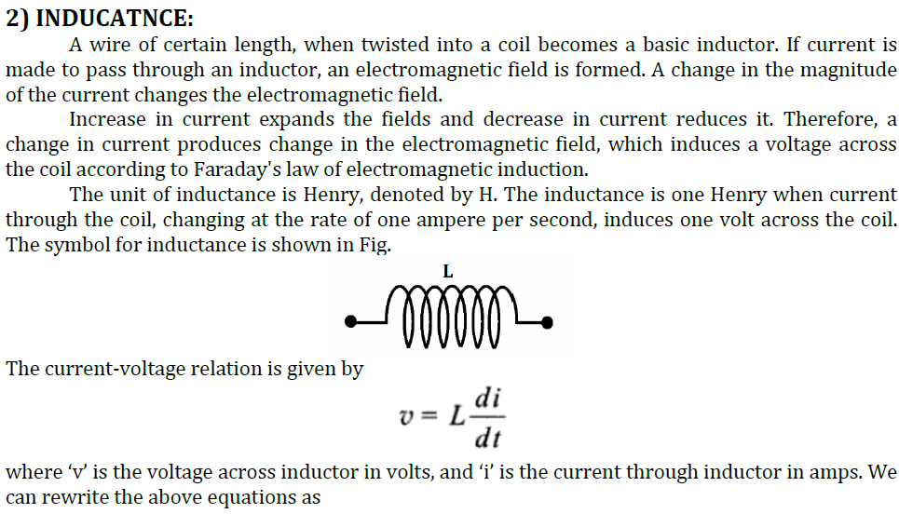

Slide 35
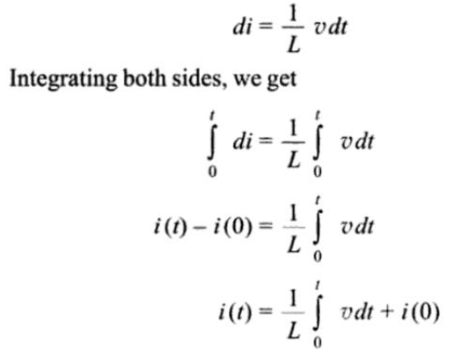

Slide 36
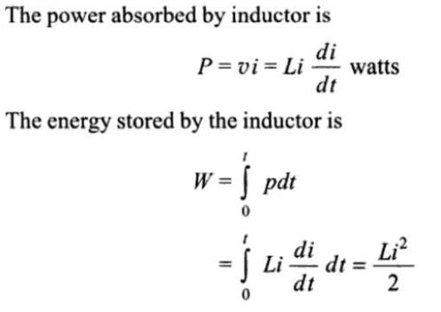

Slide 37
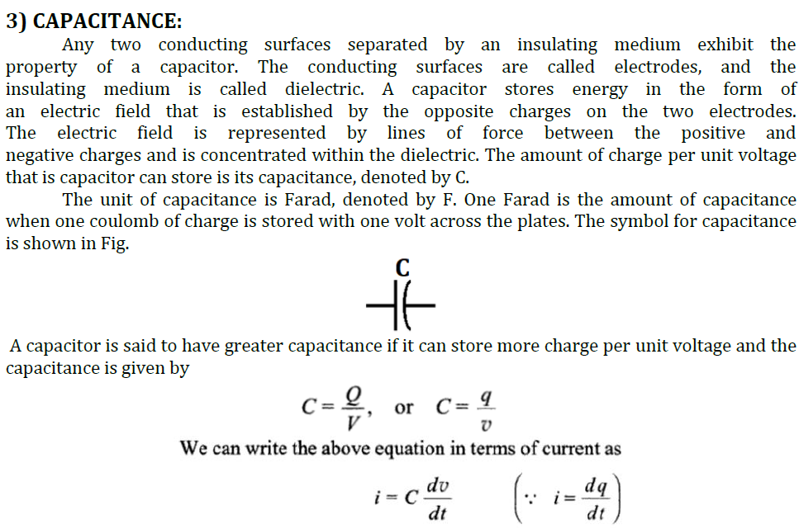

Slide 38
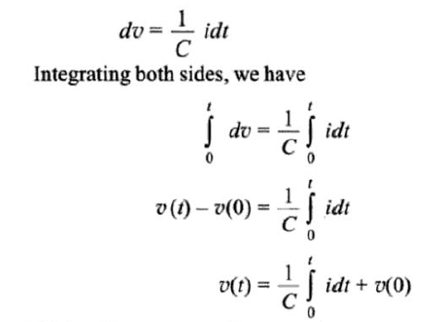

Slide 39
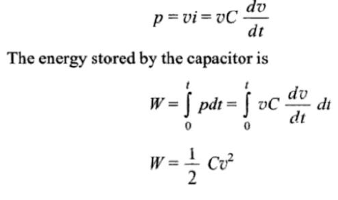

Slide 40
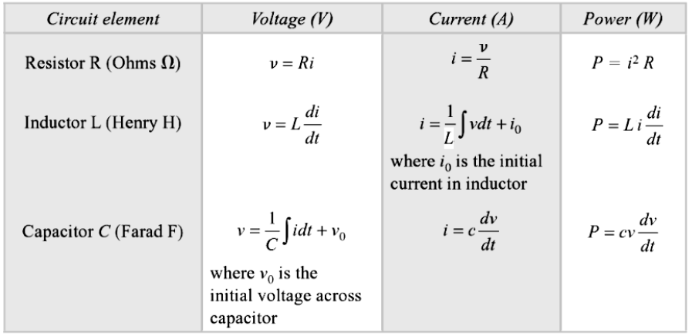

Slide 41
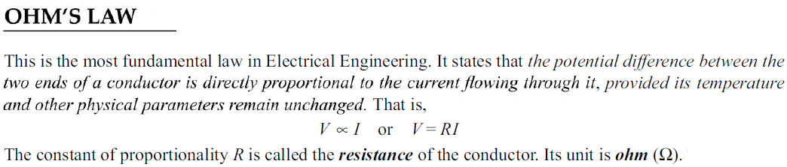
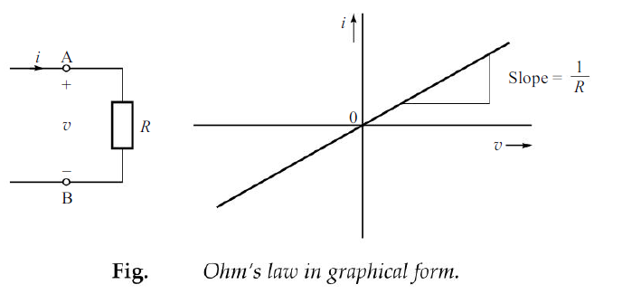

Slide 42

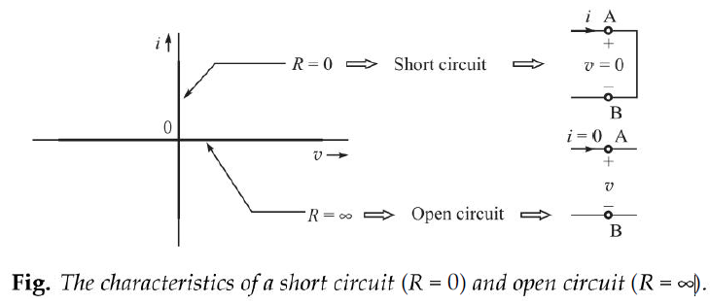

Slide 43


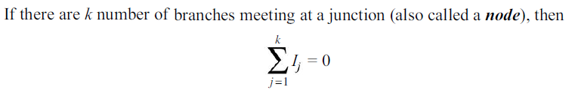

Slide 44
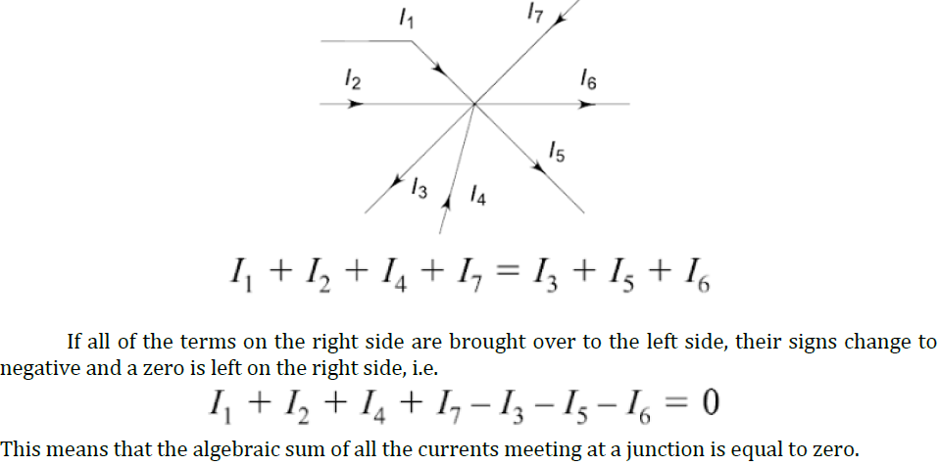

Slide 45
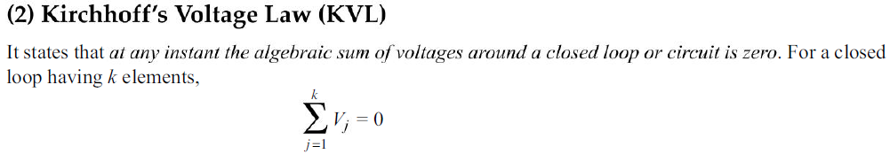
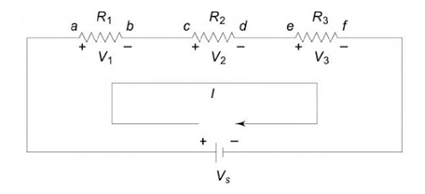
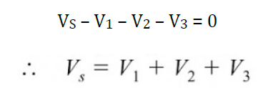

Slide 46
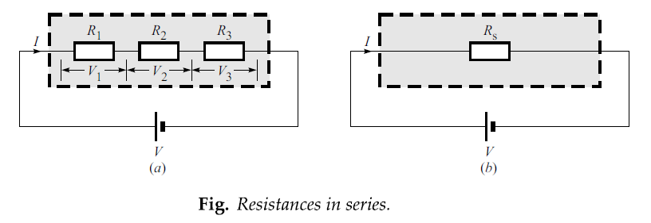
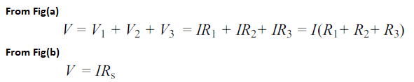
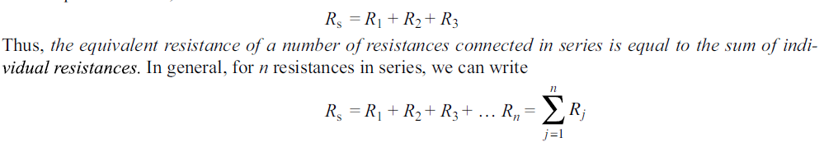

Slide 47
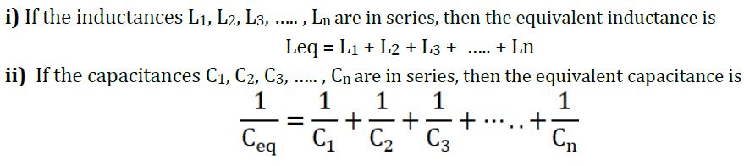

Slide 48
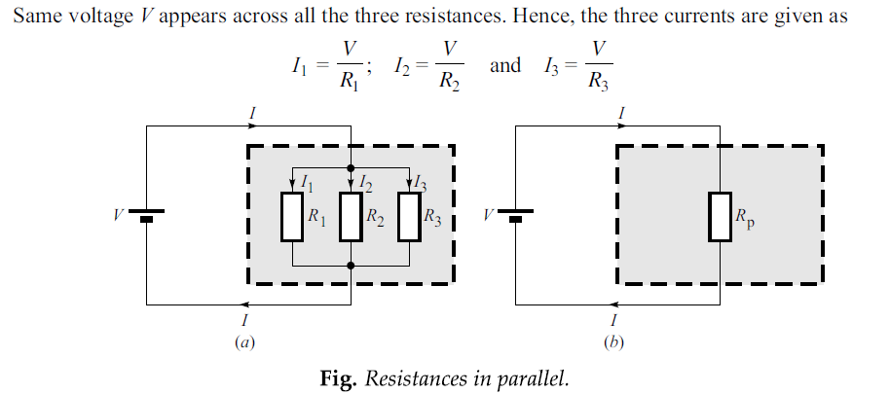

Slide 49
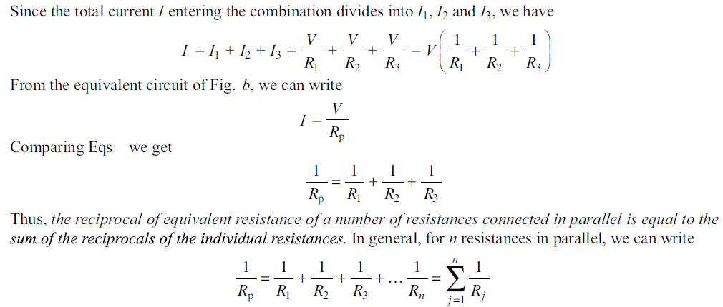

Slide 50
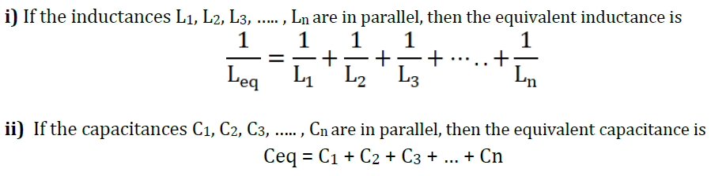

Slide 51



Slide 52



Slide 53




Slide 54



Slide 55


Slide 56

Determine the equivalent inductance of the network shown below

Slide 57


Calculate equivalent capacitance between terminals A & B

Slide 58

Examine the power absorbed by each element in the circuit if X is a 13Ω resistor.

Slide 59

Calculate the current delivered by the voltage source

Slide 60



In circuit terminology, a loop is any closed path.
A mesh is a special loop, namely, the smallest loop one can have.
In other words, a mesh is a loop that contains no other loops.

Slide 61



Slide 62


Slide 63


This theorem states that the response in a linear circuit at any point due to multiple sources can be calculated by summing the effects of each source considered separately, all other sources being made inoperative (or turned OFF).
The theorem is applicable only to a linear network (containing independent and/or dependent sources).

Slide 64


Slide 65




Slide 66

Calculate the current through 8Ω resister using superposition theorem

Slide 67
AC Circuits: A.C. Fundamentals: Equation of AC Voltage and current, waveform, time-period,frequency, amplitude, phase, phase difference, average value, RMS value, form factor, peak factor, Voltage and current relationship with phasor diagrams in R, L, and C circuits, Concept of Impedance, Active power, reactive power and apparent power, Concept of power factor (Simple Numerical problems).

Slide 68


AC Circuits
Today, the vast majority of electrical power is generated, distributed, and consumed in the form of ac power.
The term ‘ac’ means ‘alternating current’. Such a current reverses its direction periodically.
In ac power, the voltages and currents vary with time sinusoidally.

Slide 69


Slide 70

The frequency of ac supply in India is 50 Hz, which corresponds to time period, T = 1/50 = 0.02 s or 20 ms.
In USA, the frequency of ac supply is 60 Hz.

Slide 71



Slide 72



Slide 73


Slide 74


Slide 75




Slide 76


Slide 77



Slide 78


Slide 79


Slide 80


Slide 81



Slide 82


Slide 83


Slide 84


Slide 85


Slide 86


Slide 87


Slide 88


Slide 89


Slide 90


Slide 91
Types of Power
Active Power (or) Real Power (or) Average Power
Reactive Power
Apparent Power

Slide 92

i) REAL POWER/TRUE POWER/ACTIVE POWER/USEFUL POWER (P):
The power which is actually consumed or utilized in an AC Circuit is called True power or Active Power or real power.
The unit of Active or Real power is Watt.

Slide 93

ii) REACTIVE POWER/USELESS POWER/WATT LESS POWER (Q):
The powers that continuously bounce back and forth between source and load is known as reactive Power (Q).
The unit of reactive power is Volt-Ampere reactive i.e. VAR

Slide 94

iii) APPARENT POWER/COMPLEX POWER (S):
The combination of reactive power and true power is called apparent power.
The unit of Apparent power (S) : VA

Slide 95


Slide 96


Slide 97


Slide 98


Slide 99


Slide 100


Slide 101


Slide 102


Slide 103


Slide 104


Slide 105


Slide 106


Slide 107


Slide 108


Slide 109


Slide 110


Slide 111


Slide 112


Slide 113


Slide 114


Slide 115


Slide 116


Slide 117


Slide 118


Slide 119


Slide 120
Numerical Problems

Slide 121


Slide 122



Slide 123


Slide 124


Slide 125



Slide 126


Slide 127


Slide 128



Slide 129



Slide 130



Slide 131


Slide 132



Slide 133


Slide 134


Slide 135


Slide 136


Slide 137



Slide 138


Slide 139



Slide 140



